Slide 1
Simulation Based Inference Outline
Q

Slide 2
01_Simulation Based Inference - Background

Slide 3
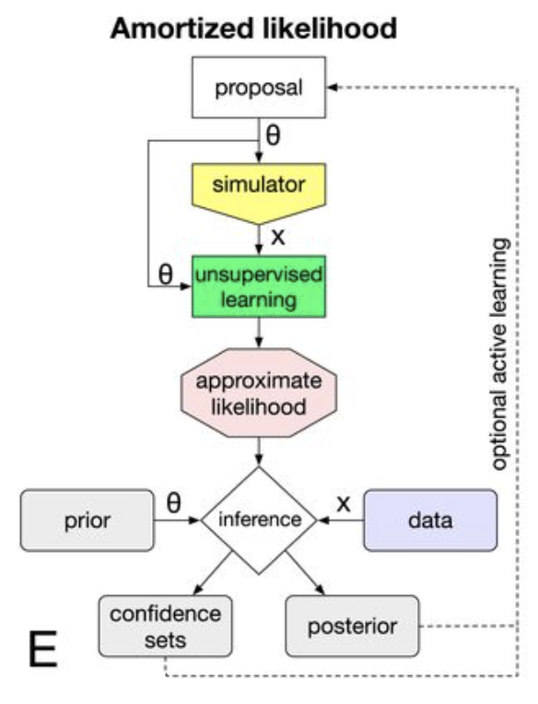
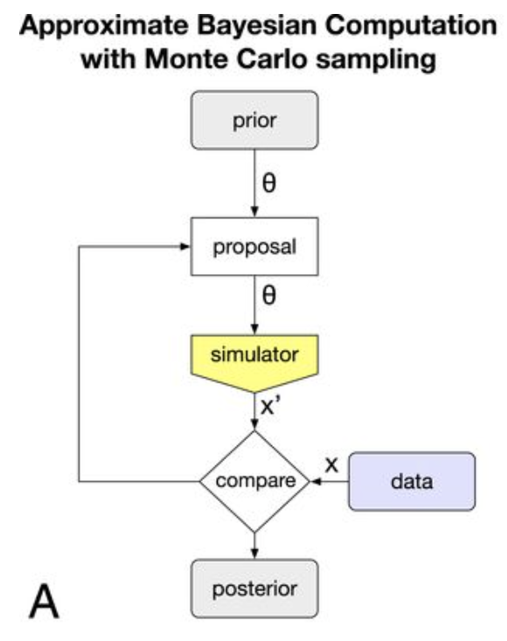

Problem –complex (process-based / ML) simulations can describe phenomena of interest to high-fidelity. However, they aren’t always well-suited for inference and lead to challenging inverse problems. Enter simulation-based inference.
The source of the challenge is that calculating the probability density (or likelihood) for a given observation is intractable.
Traditional Approaches are:
Using Density Estimation Methods to approximate the distribution of summary statistics. (E)
Approximate Bayesian Computation (Abc) compares observed and simulated data based on some distance measure. (A)
Although scientific tasks differ, a com
mon goal is: given output ‘x’, what are
the input parameters ‘theta’

Slide 4
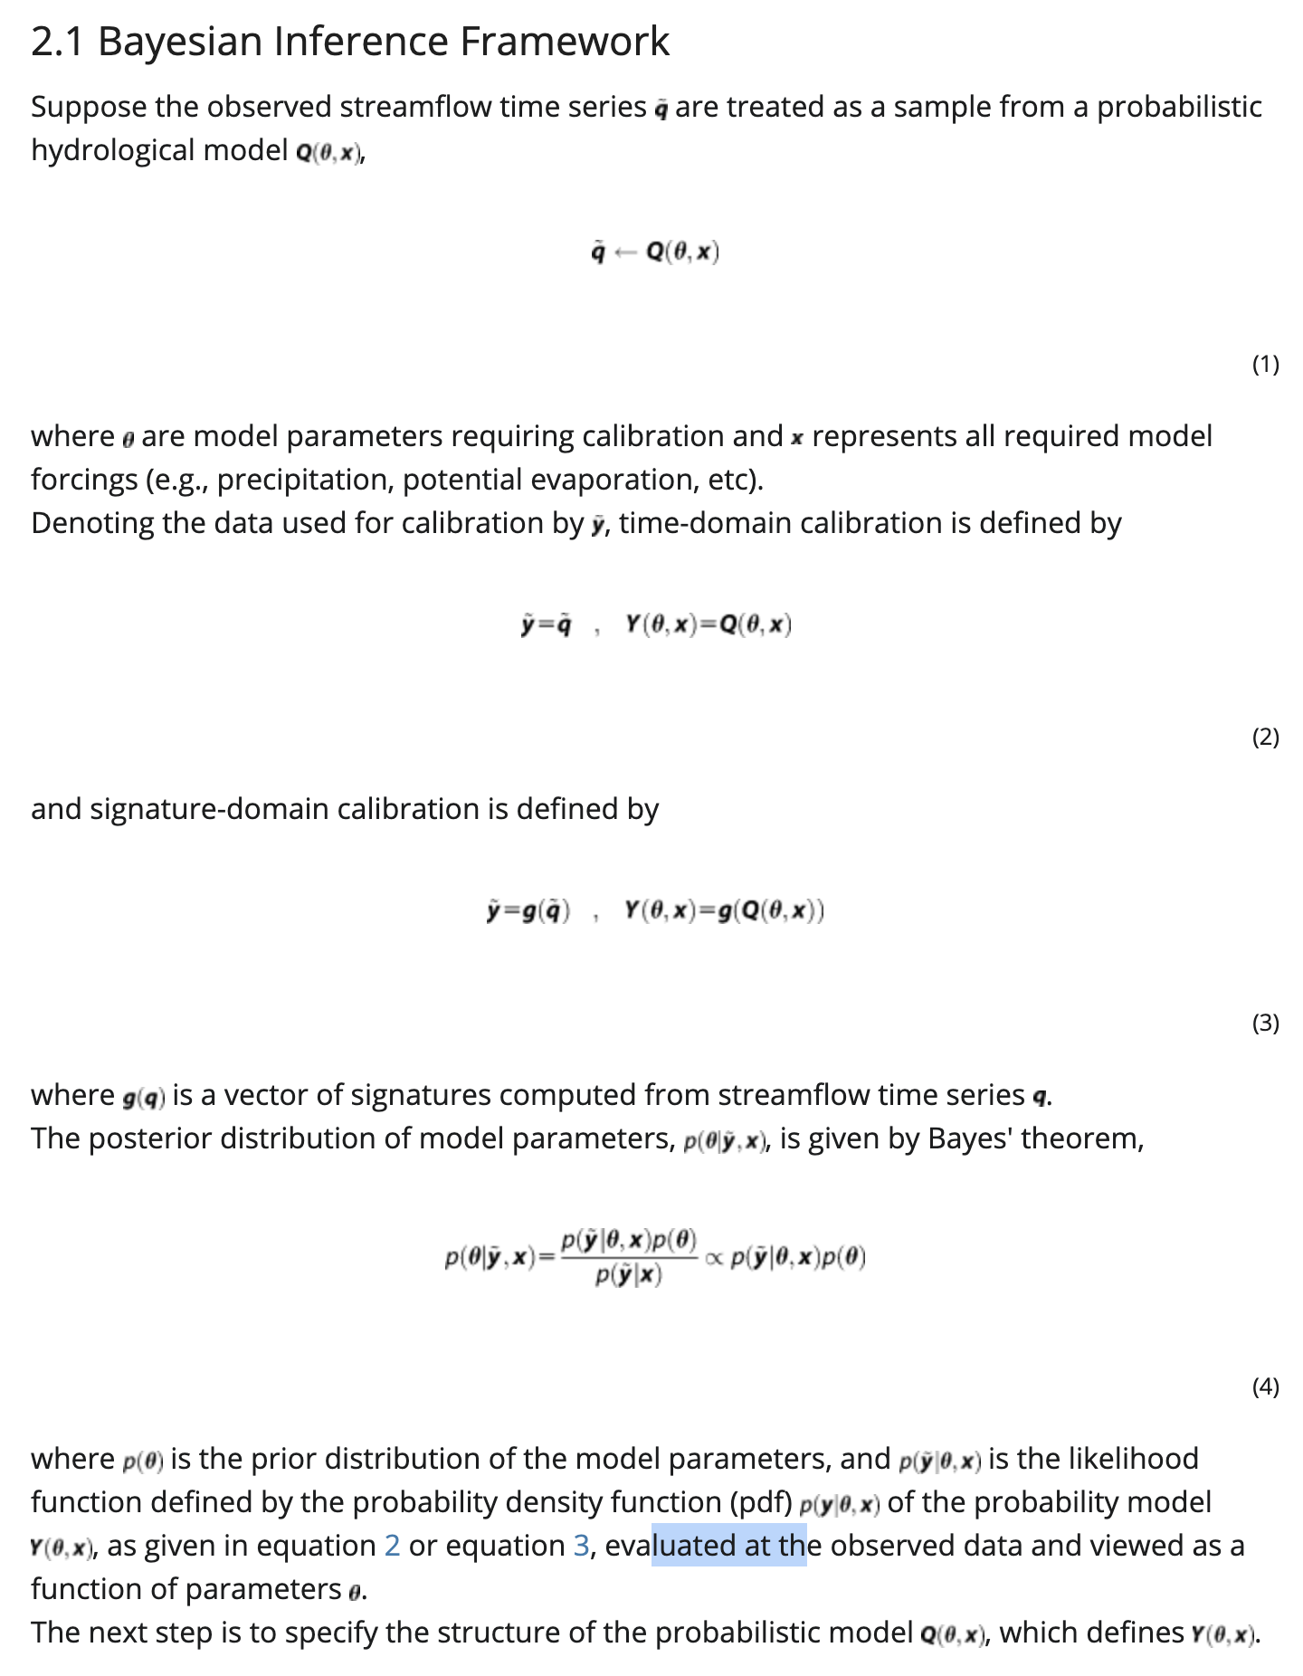
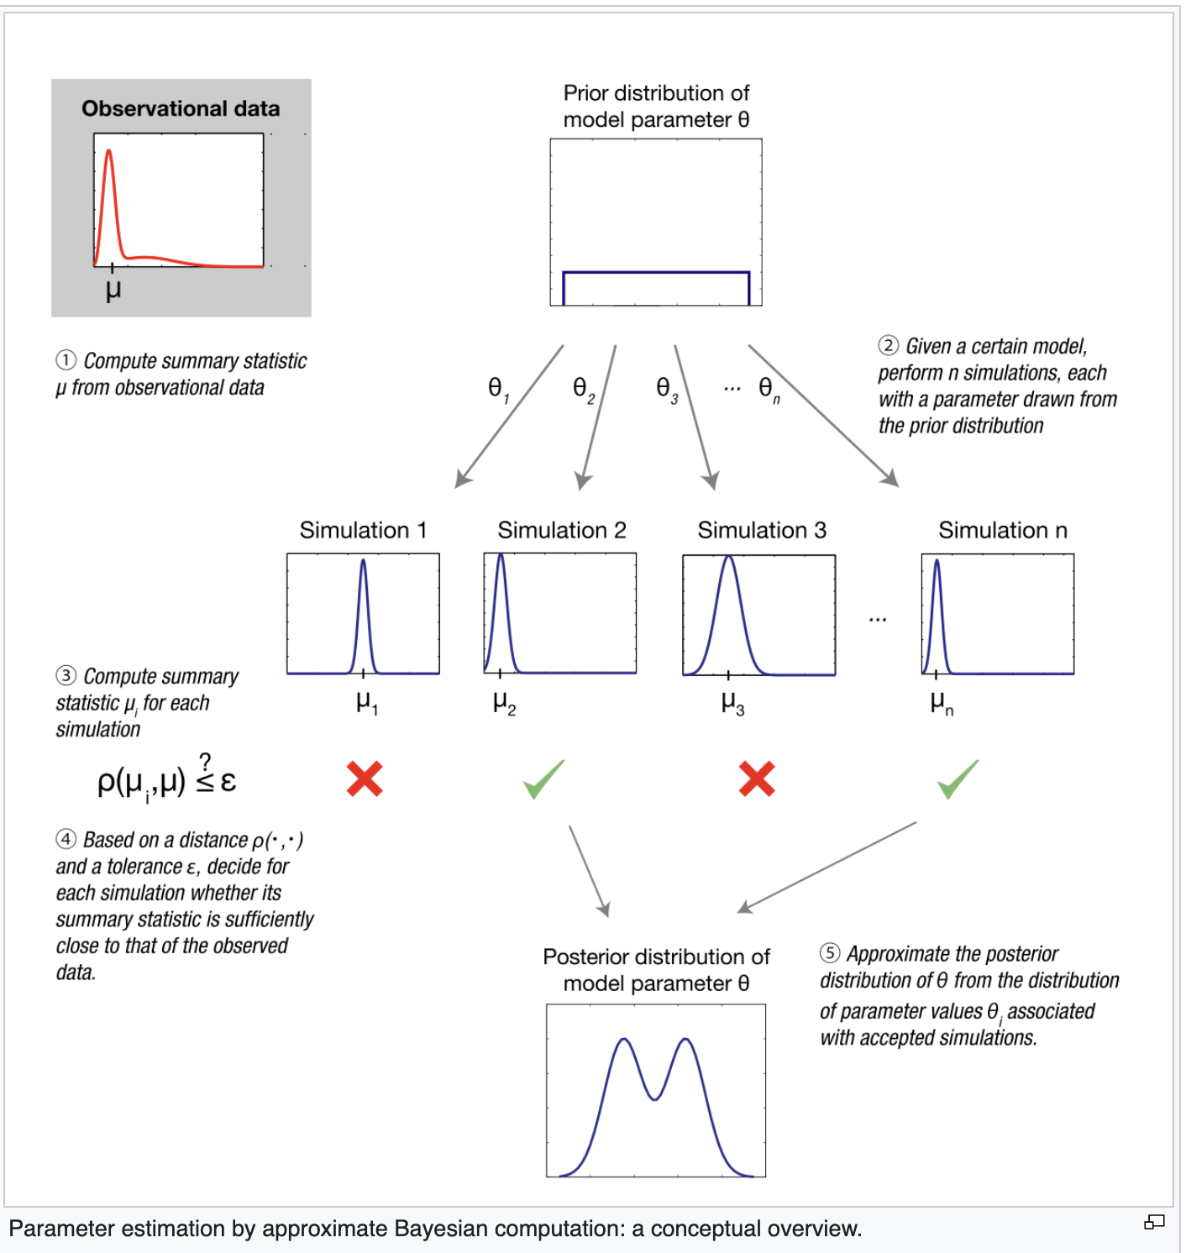
More on ABC (approximately Bayesian Computation)
Conceptual Framework.
Hydrological Framework

Slide 5
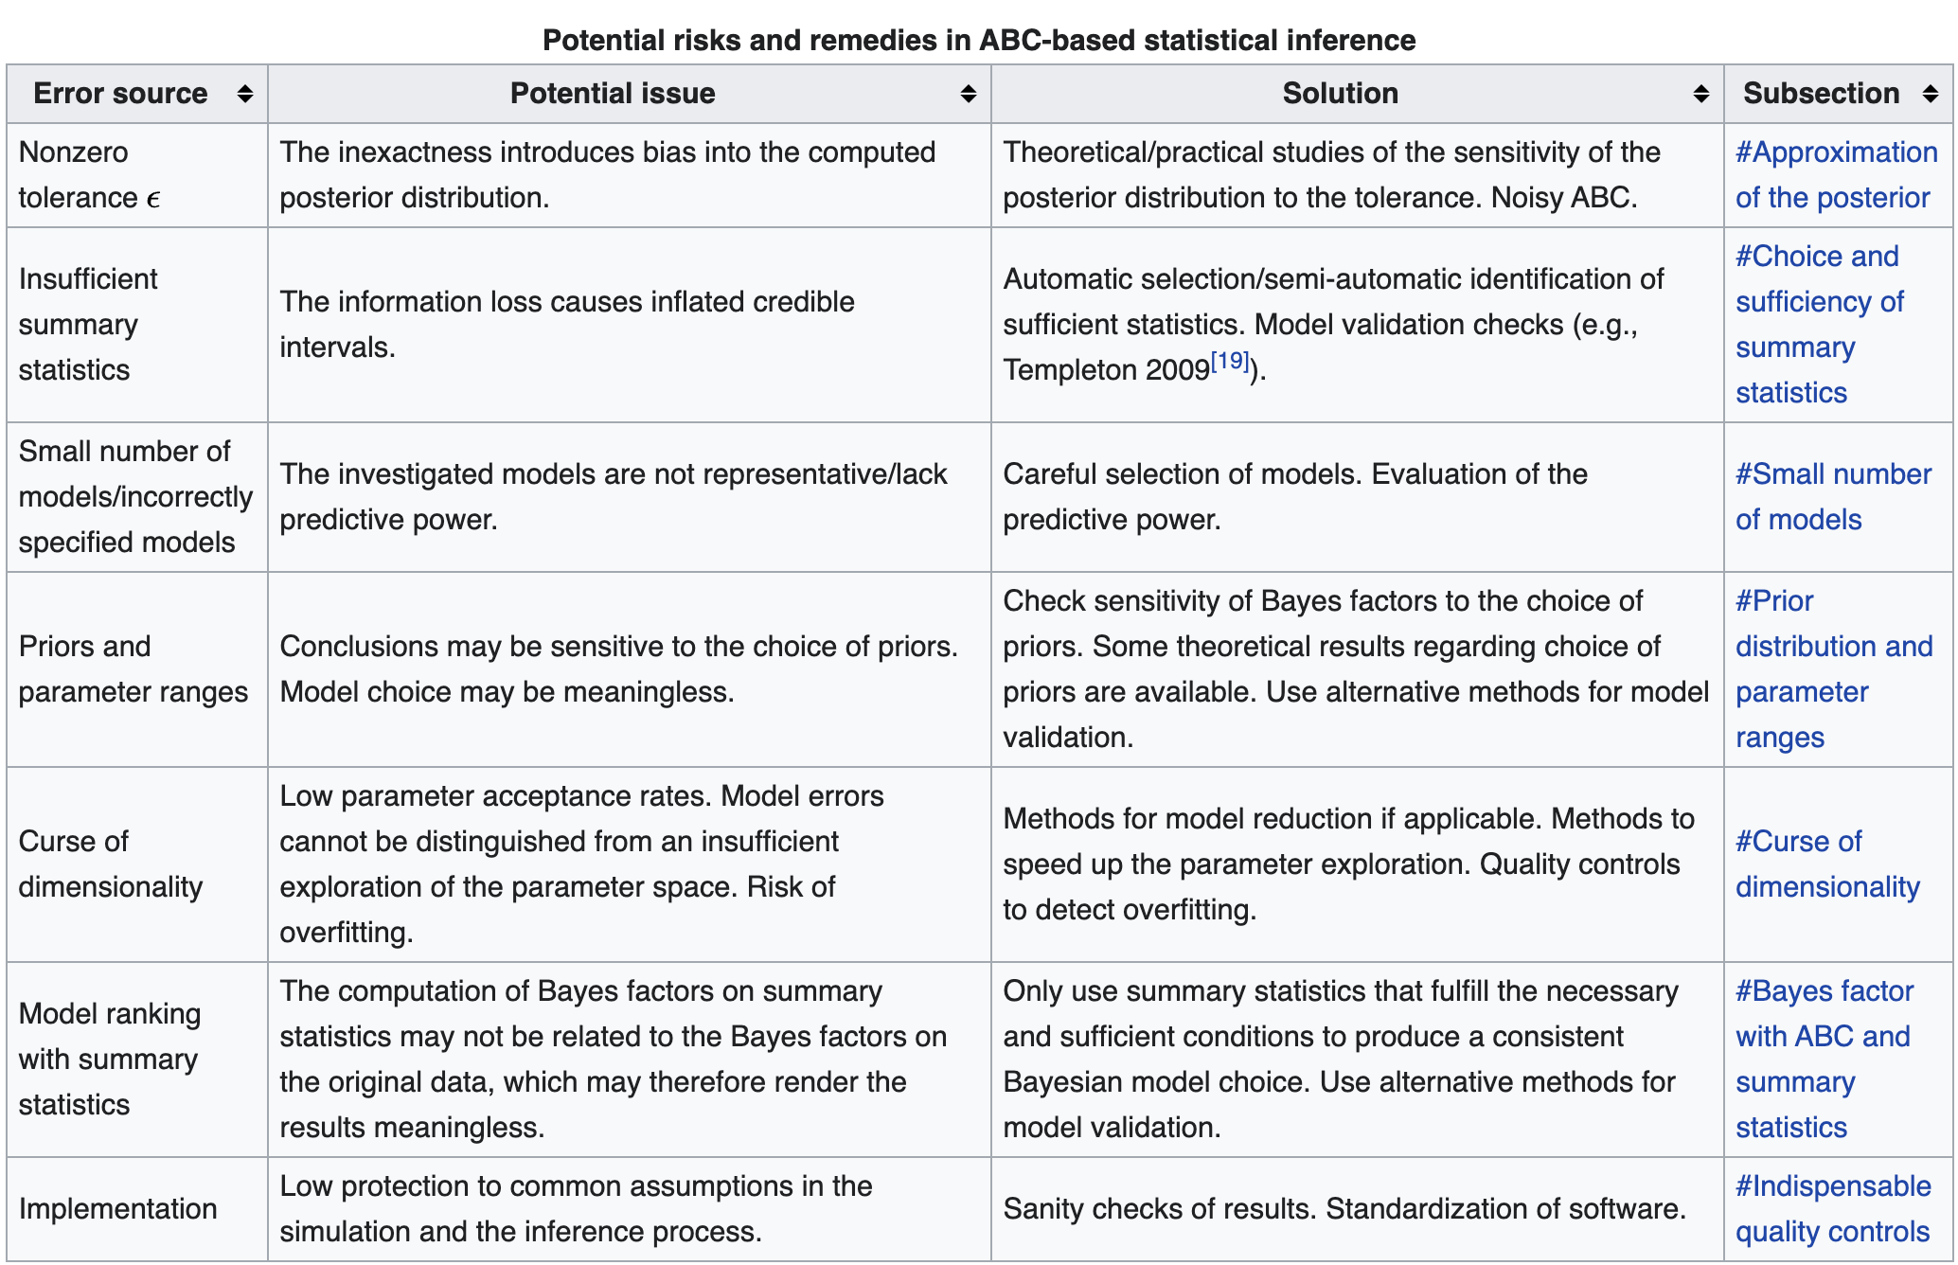
Thoughts about Simulation-Based-Inference -
ABC (Approximate Bayesian Computation) Rejection Algorithm

Slide 6
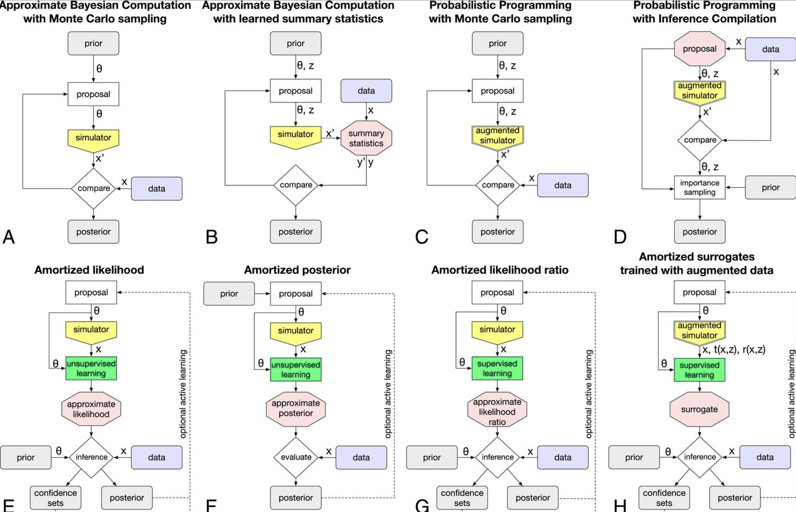
Opportunities in Simulation Based Inference

Slide 7
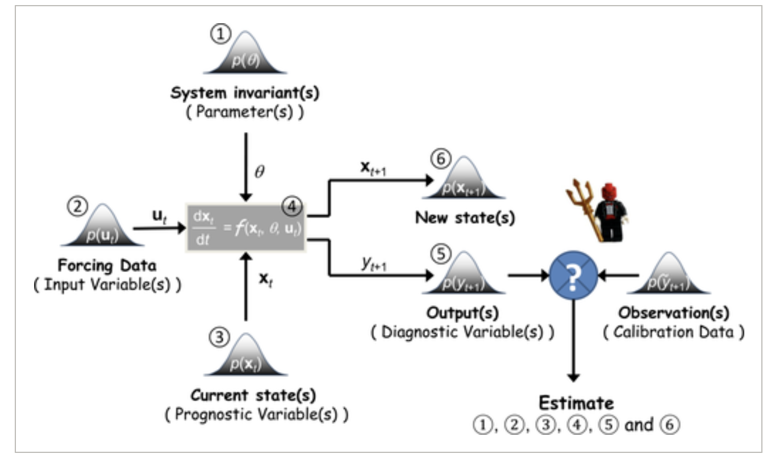
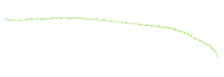


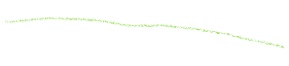
Research Direction – Simulation-Based Inference (SBI)
Goal: Fit LSTM [and/or ParFlow] model to calibration streamflow data, to improve estimates of parameter and prediction uncertainty.
Background (1): Many approaches to SBI adopt a ’Bayesian viewpoint, and relax the assumption of a single “optimum” parameter value in favor of a posterior distribution.’
Background (2): However computation of
likelihood directly is often intractable, necess-
itating methods to approximate posterior using
a summary statistic, i.e.
1. Using Density Estimation Methods.
2. Approximate Bayesian Computation (Abc)
https://www.pnas.org/content/117/48/30055#F1

Slide 8
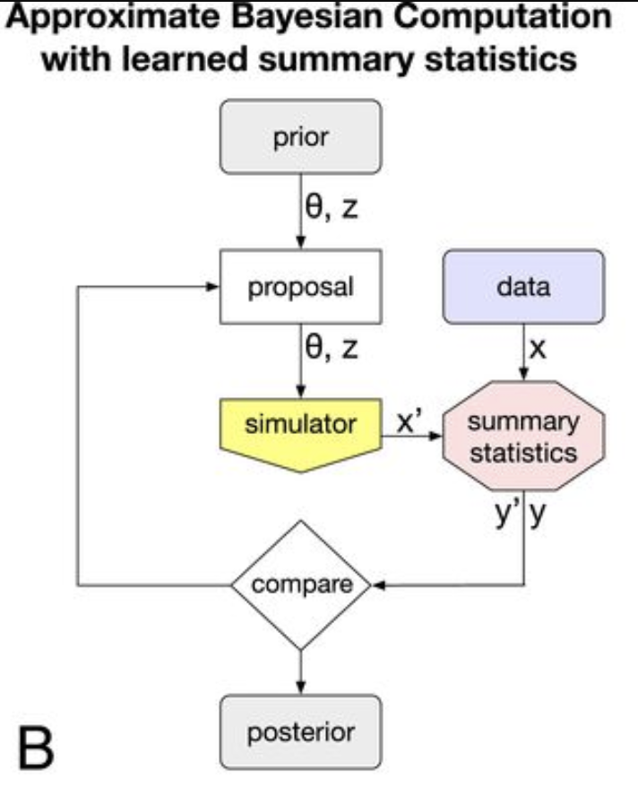
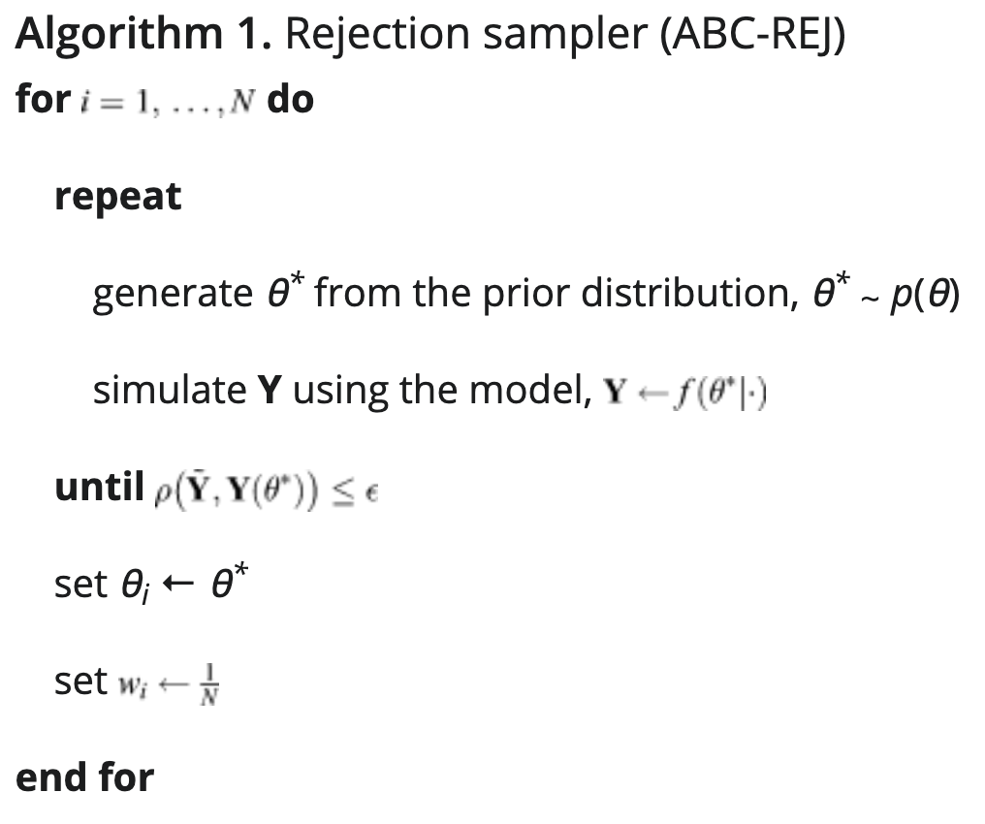
ABC-REJ Workflow (1)
A commonly-used SBI framework for streamflow model calibration
Define probabilistic streamflow model (f) and summary statistic (g) i.e. FDC, flashiness.
Define prior distribution (p) of parameters (theta) i.e porosity

Slide 9



ABC-REJ Workflow (2)
A commonly-used SBI framework for streamflow model calibration
Compute distance between simulated summary statistic y’ and observed statistic y. If greater than tolerance (epsilon), reject. Else, keep.
Evaluate Posterior once all iterations done (n)

Slide 10
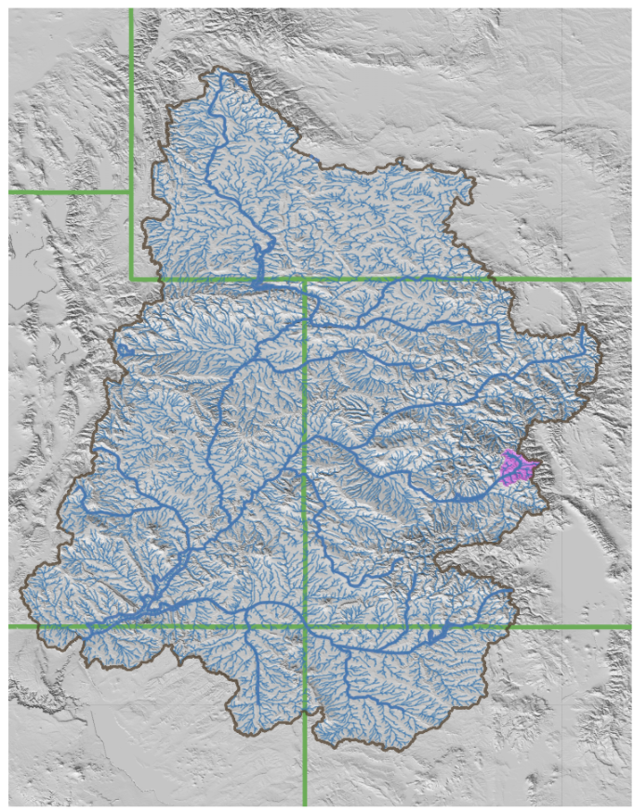
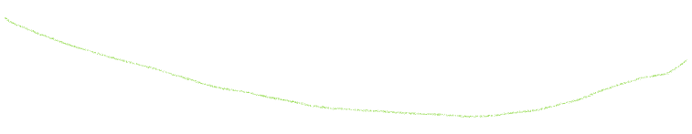

Goal: Fit LSTM model to calibration streamflow data, to improve estimates of parameter and prediction uncertainty. Taylor, only, ABC workflow
Ensemble of ParFlow Models
Probable ranges of parameter(s)
Parflow outputs (including streamflow)
data
LSTM ‘simulator’
LSTM outputs (streamflow)
Calculate Summary Statistics
Many permutations of parameter(s) - prior
Posterior
Compare Stats (Reject or Keep)

Slide 11
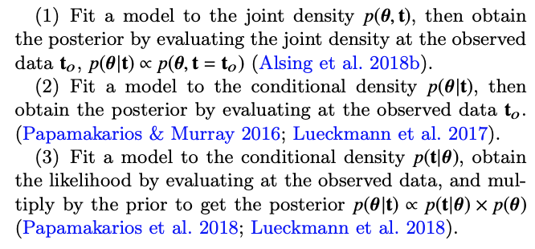
Density Estimation likelihood-free inference (DELFI)
Background (1): a flexible density estimator based on a set of simulated data-parameter pairs that infers target posterior distribution. Faster (and more flexible) than traditional ABC.
Background (2): DELFI turns inference into a density estimation task. Three principal ways are described below.
Background (3): Option 3 is generally
preferable because i) it basically learns
the likelihood p(t|theta) and is thus more
stable; ii) for applications where compressed data is ~Gaussian, simple
density estimation models can be used.

Slide 12
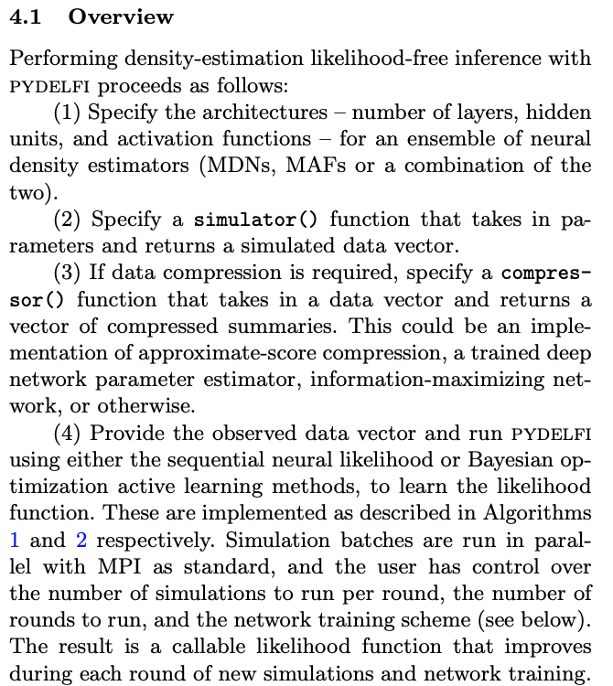
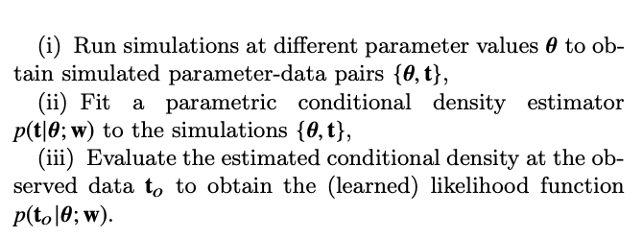

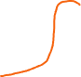
DELFI Workflow
Algorithm

Slide 13

Goal: Fit LSTM model to calibration streamflow data, to improve estimates of parameter and prediction uncertainty. Taylor only, DELFI workflow
Ensemble of ParFlow Models
Probable ranges of parameter(s)
Parflow outputs (including streamflow)
data
LSTM ‘simulator’
Compressor()
LSTM outputs (streamflow)
i.e Approx score compression
One/Many permutations of parameter(s) - prior
Conditional Density Estimator with NDE
Simulated parameter, data pairs
Adaptive Acquisition of simulations (active learning)
Likelihood & posterior
i.e. sequential or Bayesian optimization
i.e. Mixture Density Networks

Slide 14
02_Simulation Based Inference in Hydrology

Slide 16
03_Workflow and RoadMap

Slide 17
Roadmap – Base Case – K as only parameter, 20 K values parameter sweep
0. Literature Review of DELFI and ABC in Hydrology (Goal: Complete by 6/11/21)
- Short documentation of references here.
- Write up using a new (clean) document.
- Save all files and write up in new google drive + one drive pairing. (literature – notes).
- Consolidate previous notes to prevent overlap.
Domain Construction
- Come up with distribution of K values and subsample 'n' values
Get a better understanding from Elena about what it takes to generate ensembles (within Taylor). Find a way to generate these on your own. Work with her.
How many years / simulation do we need?
1 yr / 1 hr of simulation for the Taylor. So 1 year will be enough
Where do these simulations get saved and accessed?
Save them locally, and then move them over to hydrodata if wanted
How do initialize and run these simulations?
Elena will confirm this
Open Questions:
Resources
Permissions
Will these be useful to others?
Run Parflow simulations using given K values.
Ucrb git repo
Change just the K value you want to turn the knob on
Can do either/both surface and subsurface K value
Look over Code and try just 1, build from there
Careful with interpretation – probably just want to use the K value of the dominant domain that is changed so that it can be easily fed back into ParFlow

Slide 18
Roadmap (cont)
2. Build Emulator
- Train emulator using simulated outputs and parameter combinations
- Note – simple because we are only using / varying Hydraulic Conductivity.
- Note – Think about a 'better' way to encode these non time-varying attributes into LSTM
3. DELFI
- Look into PyDELFI and email developer
- See if there are any other existing workflows that could be borrowed
- Try to put in the LSTM into this workflow and see what happens

Slide 19






Goal: Fit LSTM model to calibration streamflow data, to improve estimates of parameter values. Taylor Reservoir, DELFI workflow
Ensemble of ParFlow Models
Probable ranges of parameter(s)
Parflow outputs (including streamflow)
data
LSTM ‘simulator’
Compressor()
LSTM outputs (streamflow)
i.e Approx score compression
One/Many permutations of parameter(s) - prior
Conditional Density Estimator with NDE
Simulated parameter, data pairs
Adaptive Acquisition of simulations (active learning)
Likelihood & posterior
i.e. sequential or Bayesian optimization
i.e. Mixture Density Networks

Slide 20


Goal: Fit LSTM model to calibration streamflow data, to improve estimates of parameter values. Taylor Reservoir, DELFI workflow
Ensemble of ParFlow Models
Probable ranges of parameter(s)
Parflow outputs (including streamflow)
data
LSTM ‘simulator’
Compressor()
LSTM outputs (streamflow)
i.e Approx score compression
One/Many permutations of parameter(s) - prior
Conditional Density Estimator with NDE
Simulated parameter, data pairs
Adaptive Acquisition of simulations (active learning)
Likelihood & posterior
i.e. sequential or Bayesian optimization
i.e. Mixture Density Networks

Slide 21


Goal: Fit LSTM model to calibration streamflow data, to improve estimates of parameter values. Taylor Reservoir, DELFI workflow
Ensemble of ParFlow Models
Probable ranges of parameter(s)
Parflow outputs (including streamflow)
data
LSTM ‘simulator’
Compressor()
LSTM outputs (streamflow)
i.e Approx score compression
One/Many permutations of parameter(s) - prior
Conditional Density Estimator with NDE
Simulated parameter, data pairs
Adaptive Acquisition of simulations (active learning)
Likelihood & posterior
i.e. sequential or Bayesian optimization
i.e. Mixture Density Networks

Slide 22
04_Action Items
See todoist -> https://todoist.com/showTask?id=4431398425

Slide 23
05_Questions

Slide 24
How do we run and save additional ParFlow ensembles? Simple test case

Slide 25
99_Literature Review

Slide 26
Literature Review and References:
[1] – The frontier of simulation-based inference, Cranmer et al, 2020. https://www.pnas.org/content/117/48/30055#abstract-1
[2] – Toward diagnostic model calibration and evaluation: Approximate Bayesian ComputationVrugt and Sadegh, 2013 https://agupubs.onlinelibrary.wiley.com/doi/full/10.1002/wrcr.20354
[3] – Signature-Domain Calibration of Hydrological Models Using Approximate Bayesian Computation: Empirical Analysis of Fundamental Properties Fenicia et al, 2018 https://agupubs.onlinelibrary.wiley.com/doi/full/10.1002/2017WR021616#wrcr23213-bib-0065
[4] - Signature-Domain Calibration of Hydrological Models Using Approximate Bayesian Computation: Theory and Comparison to Existing Applications, 2018,Kavetski et al https://agupubs.onlinelibrary.wiley.com/doi/10.1002/2017WR020528
[5] – Chapter 3: Learning in Parametric Modeling: Basic Concepts and Directions Theodoris https://www.sciencedirect.com/science/article/pii/B978012818803300012X
[6] – Inferring Coalsence Times from DNA Sequence Dat. Tavare et al, 1997 https://www.ncbi.nlm.nih.gov/pmc/articles/PMC1207814/pdf/ge1452505.pdf
[7] – Fast likelihood-free cosmology with neural density estimators and active learning Asling et al 2019 https://arxiv.org/pdf/1903.00007.pdf
[8] – Massive Optimal data compression and density estimation for scalable, likelihood-free inference in cosmology Asling et al 2018 https://arxiv.org/abs/1801.01497
[9] - https://docs.google.com/document/d/1fDTu-kN__vuLPHKoR9d5wM_7P_uqq1C2DWcAXS83HYE/edit

